Slide 1

Lecture 9: Introduction to Deep Reinforcement Learning: Actor-Critic
Hands on Artificial Intelligence and Robotics
Lingxiao Wang, Ph.D.
Assistant Professor of Electrical Engineering
Louisiana Tech University

Slide 2
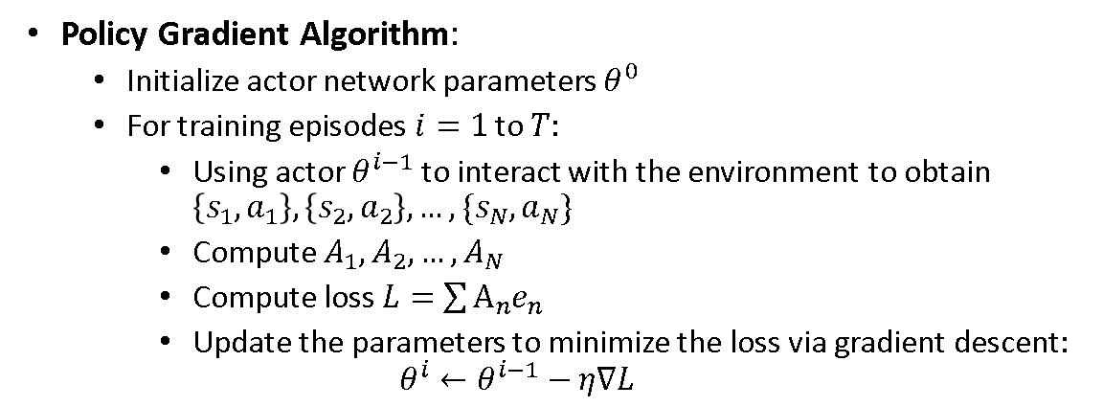
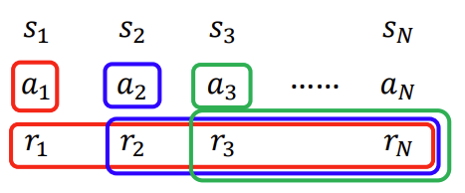
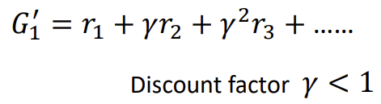
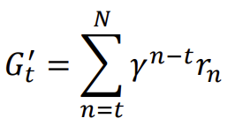

Policy Gradient Review
$A_{1}, A_{2}, …A_{N}$ are cumulated rewards ($G_{t}′$) – baseline.

Slide 3
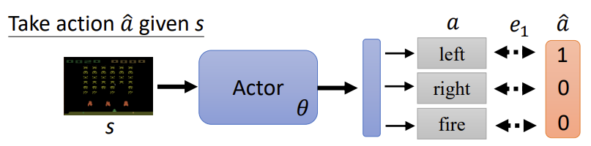

Policy Gradient Review
$e_{n}$ is the cross-entropy between the actor prediction and ‘true labels’ (true labels are $An$)
$$e_{n}=−log⁡(θ(s))$$

Slide 4
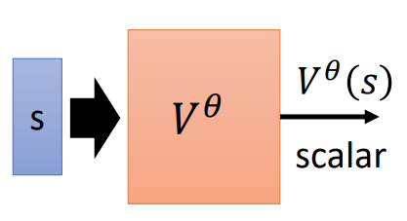
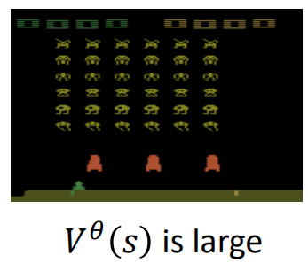
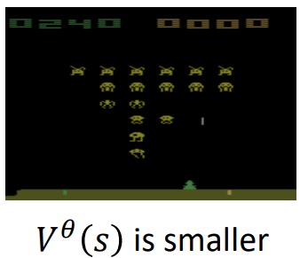
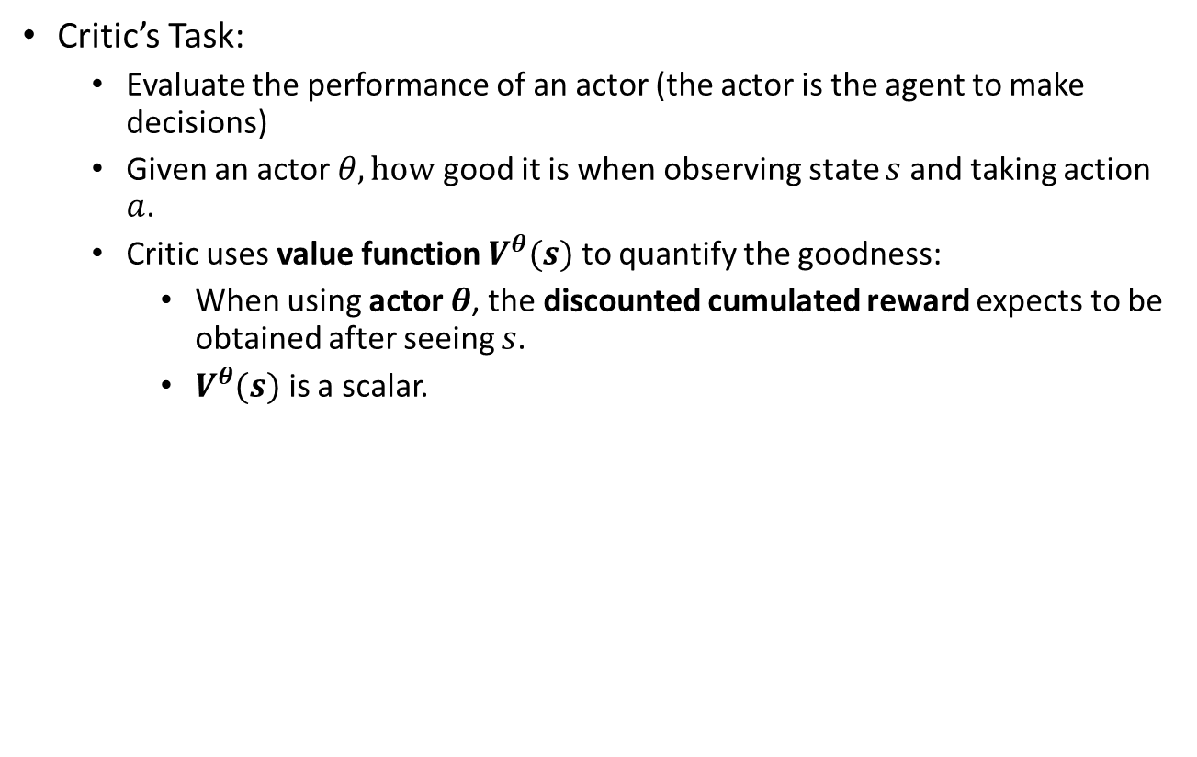
Actor-Critic
Critic’s Task:
Evaluate the performance of an actor (the actor is the agent to make decisions)
Given an actor $θ, how$ good it is when observing state $s$ and taking action $a$.
Critic uses value function $V^{θ}(s)$ to quantify the goodness:
When using actor $θ$, the discounted cumulated reward expects to be obtained after seeing $s$.
$V^{θ}(s)$ is a scalar.
The expected reward
is large
The expected reward
is small

Slide 5
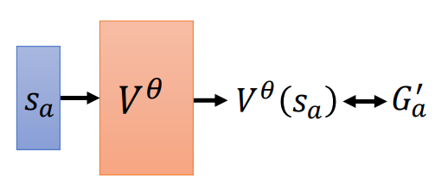
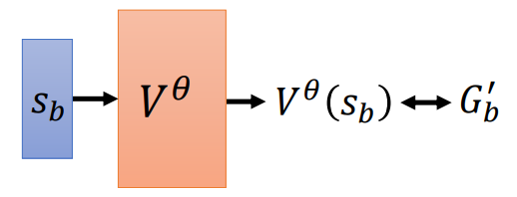
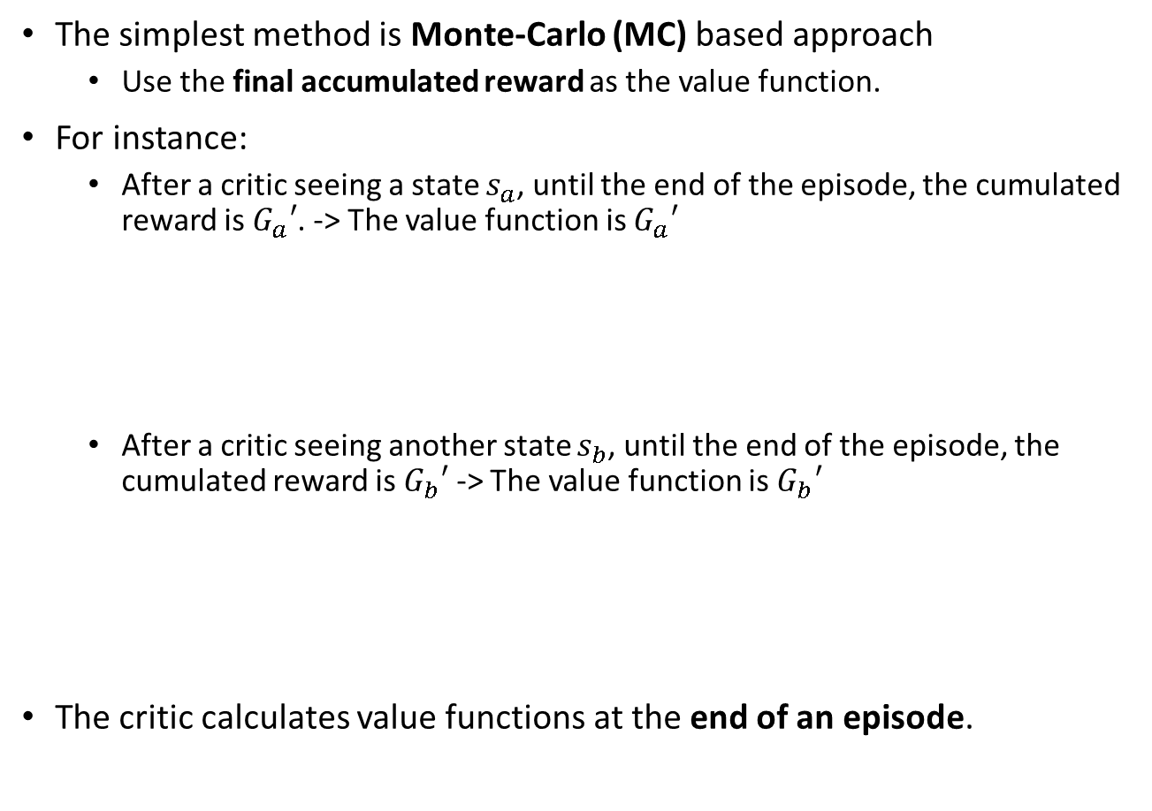
How to calculate value function $V^{θ}(s)$?
The simplest method is Monte-Carlo (MC) based approach
Use the final accumulated reward as the value function.
For instance:
After a critic seeing a state $s_{a}$, until the end of the episode, the cumulated reward is $G_{a}′$. -> The value function is $G_{a}′$
After a critic seeing another state $s_{b}$, until the end of the episode, the cumulated reward is $G_{b}′$ -> The value function is $G_{b}′$
The critic calculates value functions at the end of an episode.

Slide 6

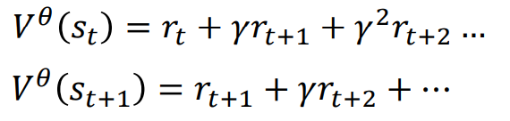

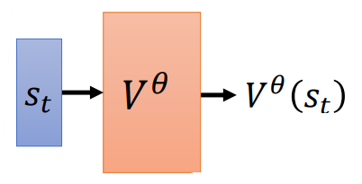
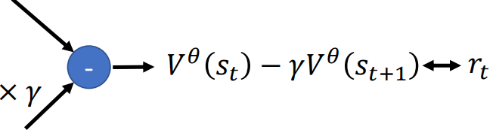
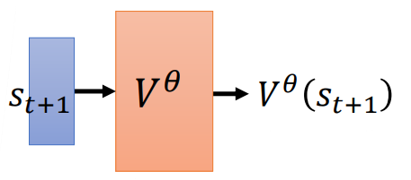
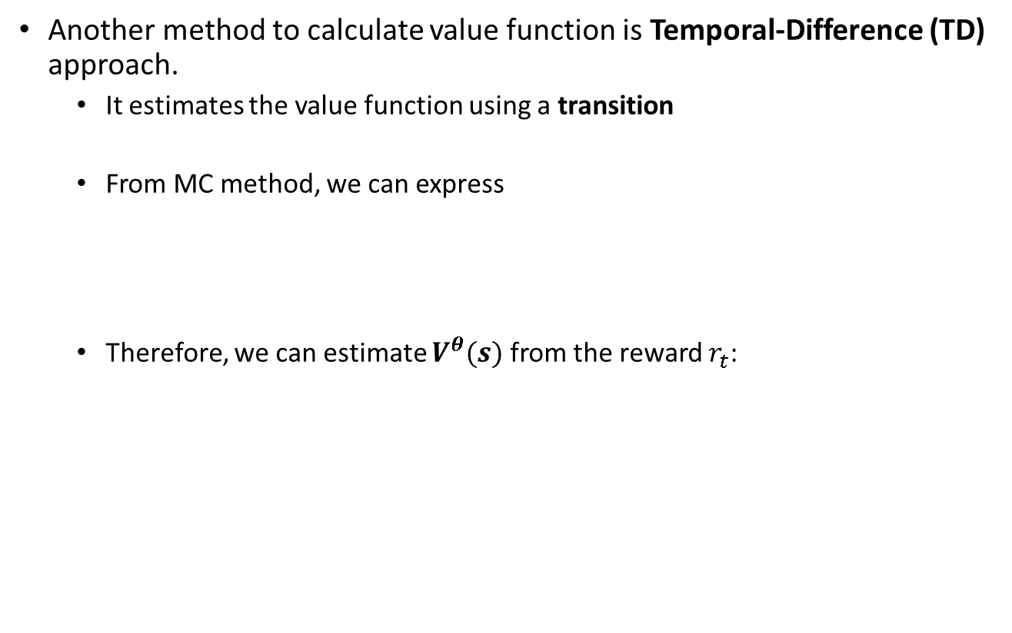
How to calculate value function $V^{θ}(s)$?
Another method to calculate value function is Temporal-Difference (TD) approach.
It estimates the value function using a transition
From MC method, we can express
Therefore, we can estimate $V^{θ}(s)$ from the reward $r_{t}$:

Slide 7
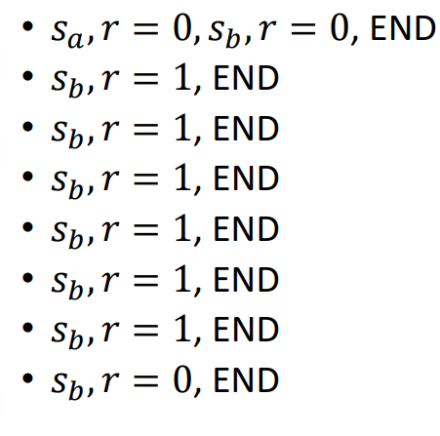




MC v.s. TD
The critic has observed the following 8 episodes:
Assume $γ=1$, find $V^{θ}\left(s_{a}\right)$ and $V^{θ}\left(s_{a}\right)$ using both MC and TD methods.
Solution:
For MC$: V^{θ}\left(s_{b}\right)=\frac{6}{8}\text{= }\frac{3}{4}\text{ ;} V^{θ}\left(s_{a}\right)=0;$
For TD: $V^{θ}\left(s_{b}\right)=\frac{3}{4}$
For Episode 1:
$$V^{θ}\left(s_{a}\right)=\frac{3}{4}$$

Slide 8
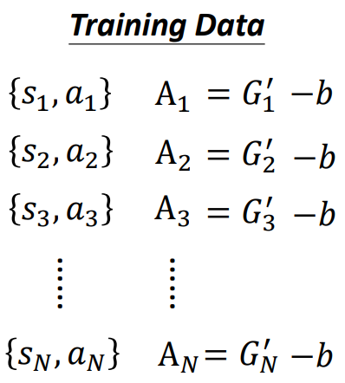
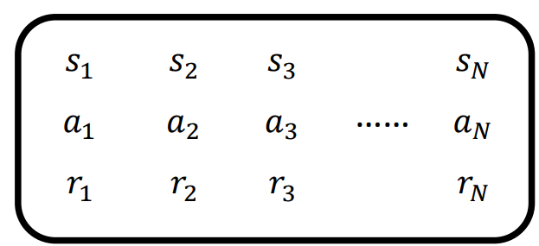
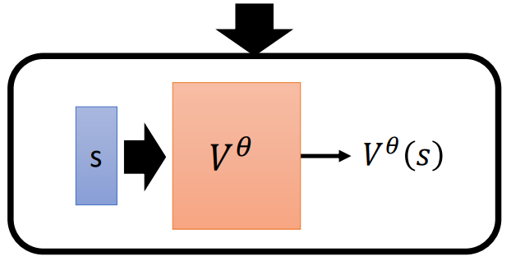
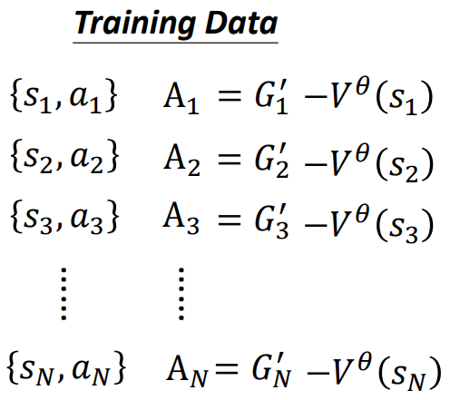


How to add critic in the training process?
In policy gradient, we use actor to interact with the environment to get training data:
$A_{1},A_{2},…$ indicate the goodness of selecting $a_{1}$ at $s_{1}$
Here, $b$ is a base value
The value of $b$ can be defined as value function.
Use these value functions as the base value in $A_{1}, A_{2},…$
For each state, we calculate a value function

Slide 9

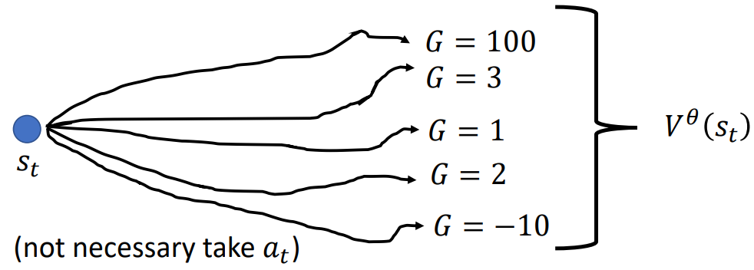
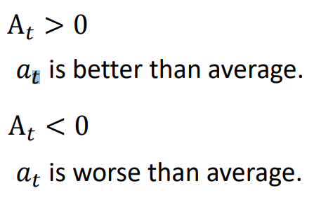
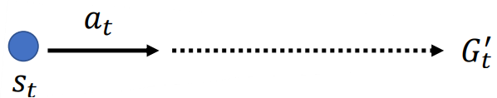

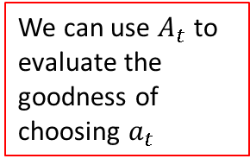
How to add critic in the training process?
Why can we use value function as the base value?
Suppose that we have:
$A_{t}$ is a scalar that indicates the goodness of acting $a_{t}$ at $s_{t}$.
$V^{θ}(s_{t})$ is the expected reward obtained starting at $s_{t}.$
This is an expected (i.e., averaged) value since the actor can use different actions to generate different episodes.
Now, if the actor takes the action $a_{t}$ and get the cumulated reward $G_{t}′$ at the end of episode:
We can use $A_{t}$ to evaluate the goodness of choosing $a_{t}$

Slide 10
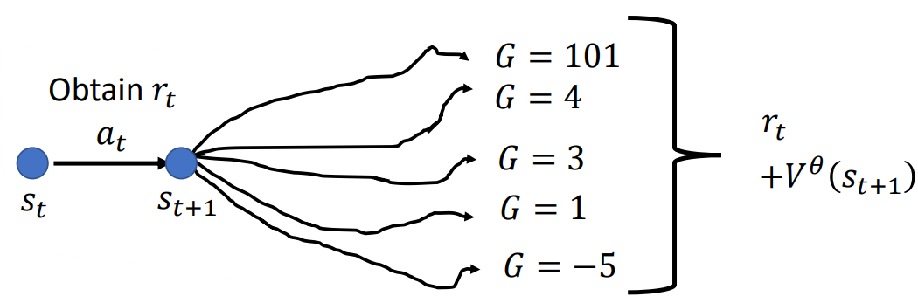





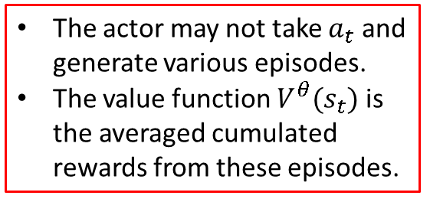

Advantage Actor-Critic
$A_{t}$ is named as the Advantage Function.
The actor may not take $a_{t}$ and generate various episodes.
The value function $V^{θ}(s_{t})$ is the averaged cumulated rewards from these episodes.
The actor takes $a_{t}$ and then act randomly to generate various episodes.
At $s_{t+1}, t$he value function $V^{θ}(s_{t+1})$ is the averaged cumulated rewards from these episodes.
At $s_{t}$, the value function is $r_{t}+{γV}^{θ}(s_{t+1})$
$$A_{t}$$
$$=G_{t}^{′}$$
$$−V^{θ}\left(s_{t}\right)$$
$$A_{t}=r_{t}+γV^{θ}\left(s_{t+1}\right)−V^{θ}(s_{t})$$

Slide 11
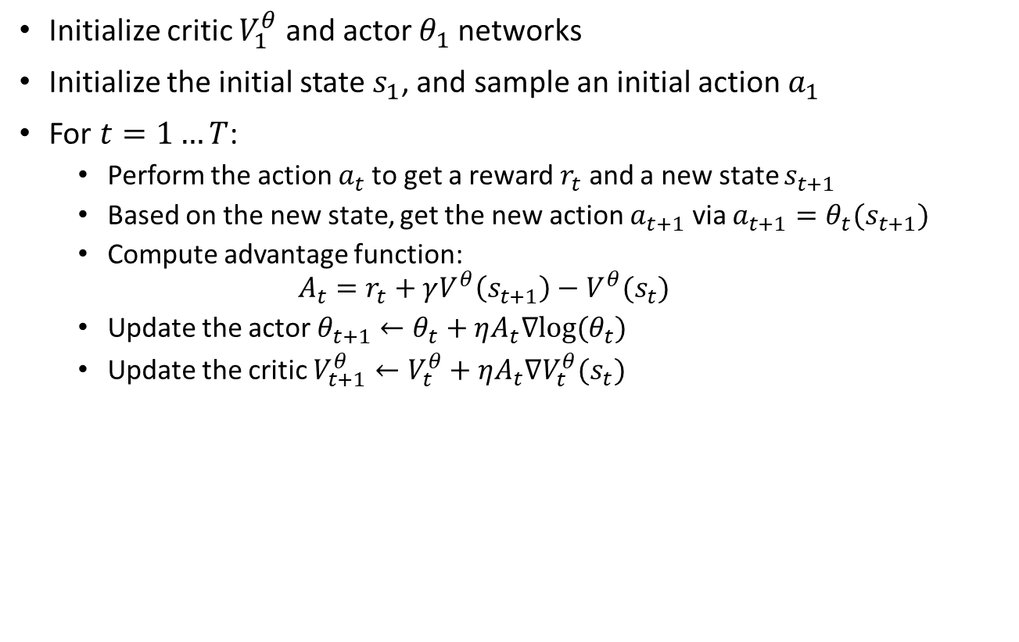
Advantage Actor-Critic Algorithm
Initialize critic $V_{1}^{θ}$ and actor $θ_{1}$ networks
Initialize the initial state $s_{1}$, and sample an initial action $a_{1}$
For $t=1…T$:
Perform the action $a_{t}$to get a reward $r_{t}$ and a new state $s_{t+1}$
Based on the new state, get the new action $a_{t+1}$ via $a_{t+1}=θ_{t}(s_{t+1})$
Compute advantage function:
$$A_{t}=r_{t}+γV^{θ}\left(s_{t+1}\right)−V^{θ}(s_{t})$$
Update the actor $θ_{t+1}←θ_{t}+ηA_{t}∇log⁡(θ_{t})$
Update the critic $V_{t+1}^{θ}←V_{t}^{θ}+ηA_{t}∇V_{t}^{θ}(s_{t})$

Slide 12
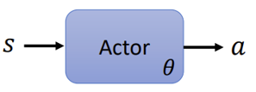
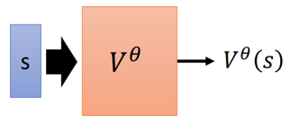
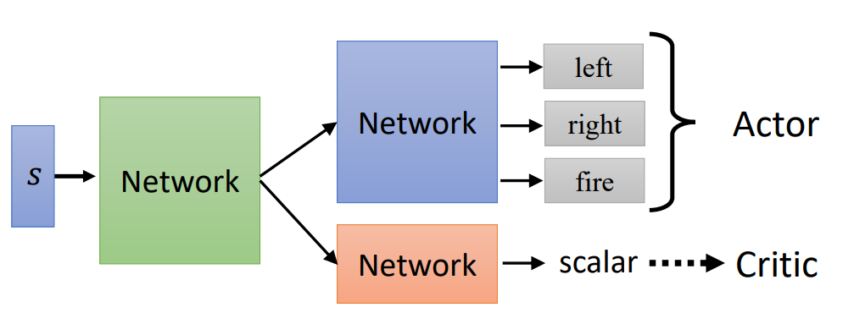
Tip of Actor-Critic
In policy gradient, actor is a network:
Input is state, output is action
In actor-critic, critic can also be a network:
Input is state, output is the value function
Therefore, parameters of actor and critic can be shared:
Sampling (i.e., collecting training data) is important in RL.
The quality of actor depends on the sampling efficiency
Diverse training data (i.e., more training scenarios) -> high quality actor

Slide 13
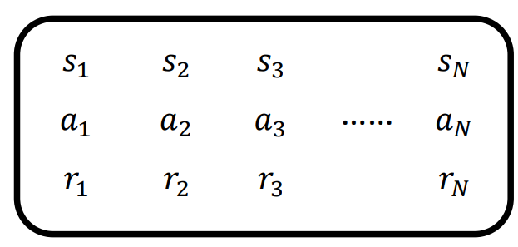
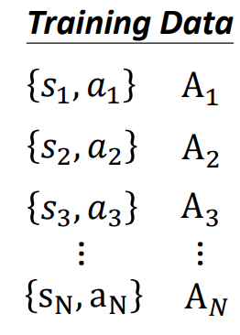

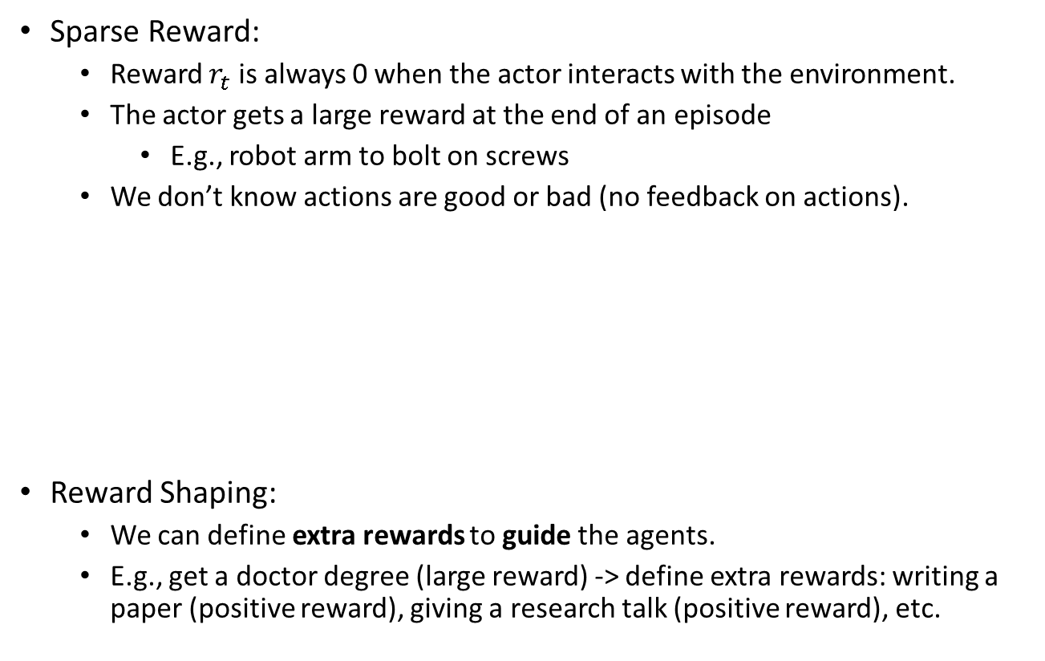

Reward Shaping
Sparse Reward:
Reward $r_{t}$ is always 0 when the actor interacts with the environment.
The actor gets a large reward at the end of an episode
E.g., robot arm to bolt on screws
We don’t know actions are good or bad (no feedback on actions).
Reward Shaping:
We can define extra rewards to guide the agents.
E.g., get a doctor degree (large reward) -> define extra rewards: writing a paper (positive reward), giving a research talk (positive reward), etc.
If $r_{t}=0$, then $A_{t}$ is very small.

Slide 14
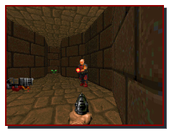
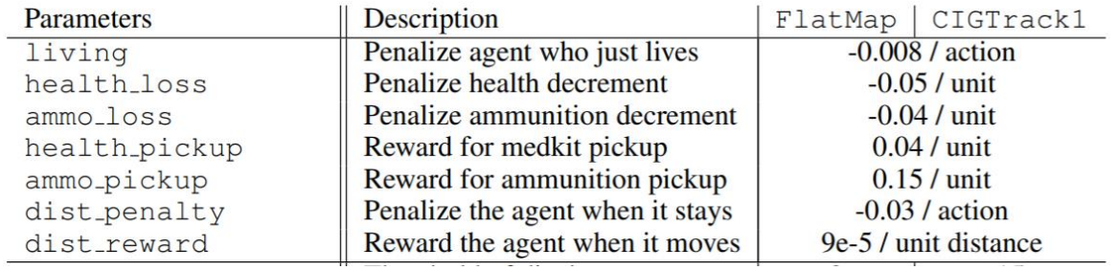
Reward Shaping Example
VizDoom: an open-source RL training environment based on a first-person shooter game DOOM.
Inputs of an actor: images
Outputs of an actor: move and fire
Final goal of the actor:
Destroy enemies to get points
Define extra rewards to guide the agent to achieve the final goal:
The actor performance is 35% higher than the actor without reward shaping (paper link: https://openreview.net/forum?id=Hk3mPK5gg&noteId=Hk3mPK5gg)

Slide 15
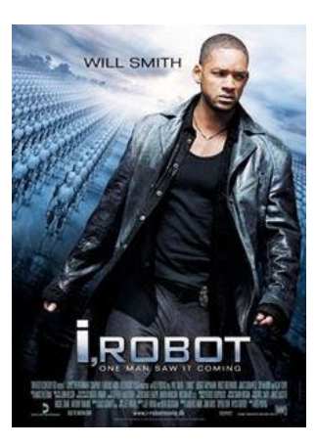
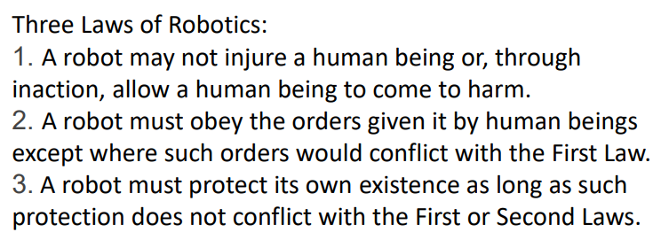
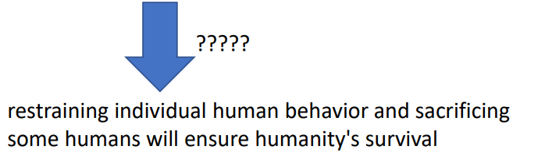
No Reward: Learning from Demonstration
Motivation:
Defining rewards can be challenging in some tasks.
E.g., training self-driving cars
Hand-crafted rewards can lead to uncontrolled behaviors.

Slide 16
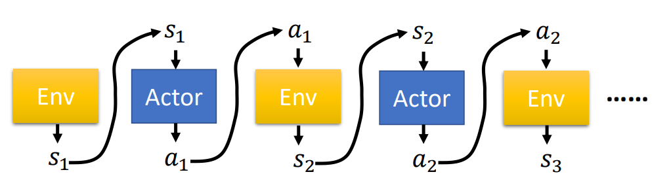

Imitation Learning
Imitation Learning:
Actor can interact with the environment, but reward is not available.
Use expert (i.e., humans) demonstrations to train the actor.
For instance:
Self driving: record human drivers to get demonstrations
Robot arms to pick objects: human grab the arm of robot to demonstrate how to pick objects.

Slide 17



Imitation Learning
Self-driving cars as an example
Isn’t the imitation learning supervised learning (learn from demonstrations)?
If just let the agent repeat human behaviors -> Behavior Cloning
However, humans only sample limited observations.
Train an agent to mimic human behaviors
Expert demonstrations may only include successful cases. So the agent don’t know how to handle unsuccessful cases.
Sometimes, the agent will copy every behavior, even irrelevant actions.
Sheldon learns Mandarin (link).

Slide 18

Inverse Reinforcement Learning
Get reward function from expert demonstration.
Once you have reward functions, then use the original RL to train the agent.
Procedures:
Let actor and teacher interact with the environment.
Define a reward function to make the teacher get a higher total reward.
This assumes teacher is always better than the actor.
Use the reward function to train the actor, making the actor get a high total reward.
Example: Teach robot arms to perform basic tasks (link)

